Slide 1
‘myGrocer’
In the following, we describe initial ideas for a new smart phone app, myGrocer, for automating supermarket purchases and checkouts. myGrocer customers own a smart phone with a camera.
The smart phone may be used to
- Automate supermarket shopping by:
o scanning purchases as they are added to the shopping cart
o automating checkout of purchases – as the customer leaves the store, a store sensor detects his/her exit and automatically totals the purchases (stored on the smart phone) and takes payment via a predetermined payment method
- Support shopping according to a nutritional profile:
o via a web browser, the customer enters a profile detailing his/her dietary restrictions, nutritional preferences etc.
o as purchases are scanned, the smart phone checks for compliance to the nutritional profile
o as the customer enters the store, the smart phone obtains and displays a list of items ‘on special’ that satisfy the nutritional profile

Slide 2
Use Case Workshop
Define Actors
1.1 Identify external entities that interact with the system;
- Also consider external systems
1.2 Write a short description for each actor.
Define Use Cases
2.1 Focus on concrete use cases
- avoid discussion about include and extend relations at this stage;
2.2 Draw lines to the relevant actors;
2.3 Every actor should have at least one use case;
2.4 Write Brief Description for each Use Case;
2.5 Identify any potential include and extend relations.
Step-by-step description of the flow of events for each use case

Slide 3
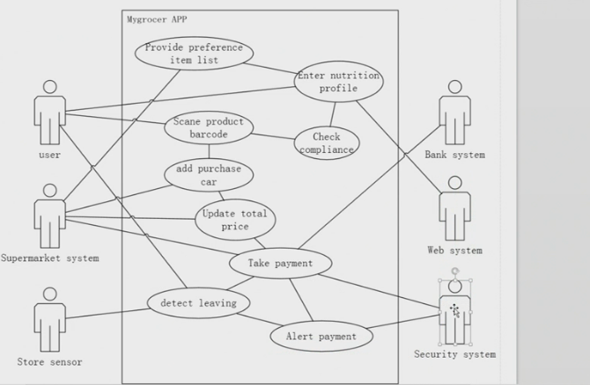

Slide 4
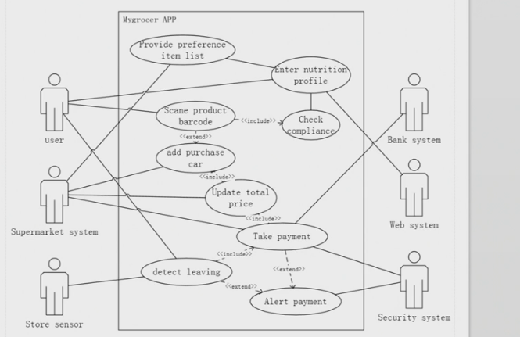
myGrocer use cases

Slide 5
Use case name:
Scope:
Primary actor:
Secondary actors:
Summary:
Preconditions:
Main success scenario:
Alternatives:
Exceptions:
Postconditions:

Slide 6
Use case name:
Scope:
Primary actor:
Secondary actors:
Summary:
Preconditions:
Main success scenario:
Alternatives:
Exceptions:
Postconditions:

Slide 7
Use case name:
Scope:
Primary actor:
Secondary actors:
Summary:
Preconditions:
Main success scenario:
Alternatives:
Exceptions:
Postconditions:

